Slide 1



CYBER
KILL CHAIN
A framework for understanding Cyber Attacks
Ajmal M S
ICTAK
Cyber Security, November 2024

Slide 2

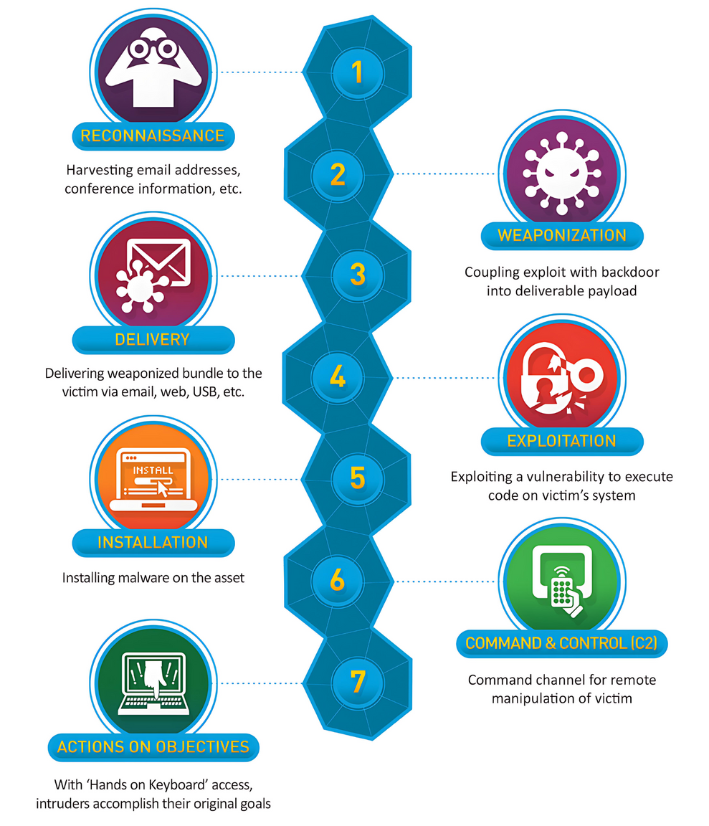

Cyber Kill Chain
What is Cyber Kill Chain?
Cyber Kill Chain is a chain of stages of a cyber attack.
This is a framework developed by Lockheed Martin that clearly describes the stages of a cyber attack from reconnaissance to data exfiltration.
It helps organizations understand, detect, and respond to threats/attacks
Image Ref - https://phoenixnap.com/blog/wp-content/uploads/2021/08/cyber-kill-chain-model.png

Slide 3



Cyber Kill Chain
Importance of the Cyber Kill Chain
Enhances the situational awareness
Breaks down complex attacks
Supports early detection and defence

Slide 4
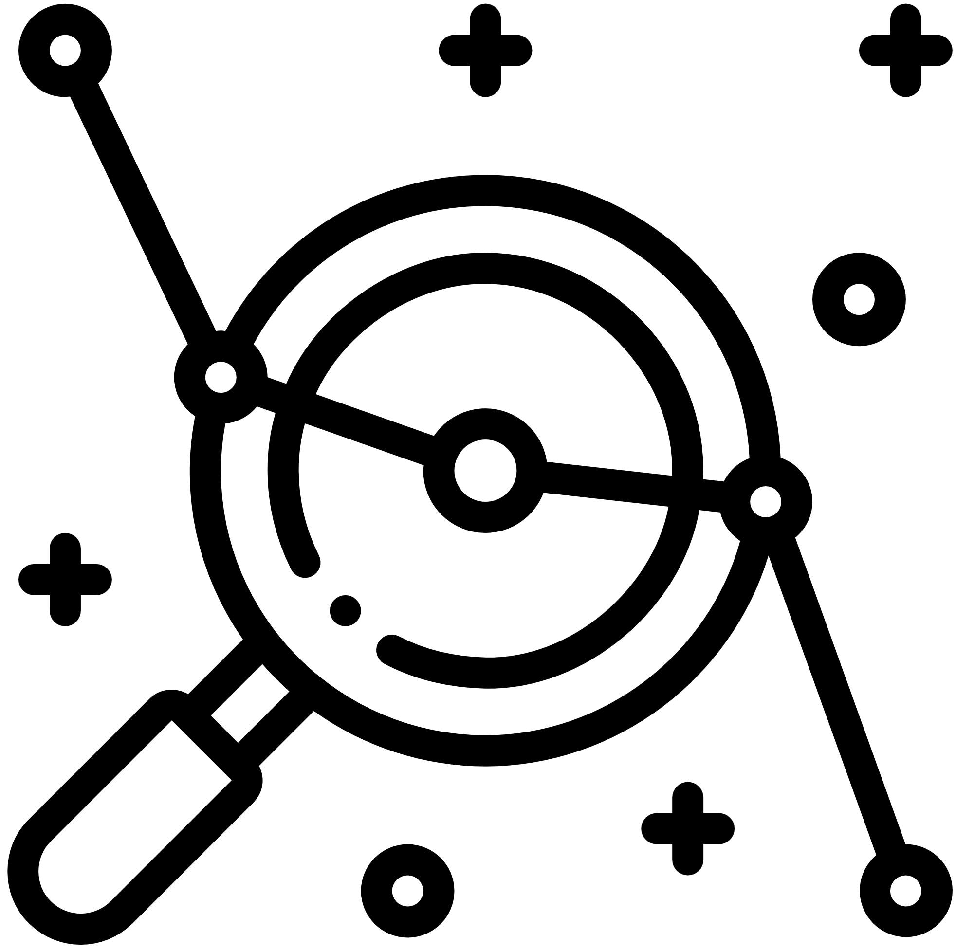
Cyber Kill Chain
Stage 1 : Reconnaissance
Reconnaissance
This is the first stage where, attacker gathers information on the target
The common tools used are social media, domain tools, and scanning software
Goal: To identify vulnerabilities/opportunities to establish an attack.

Slide 5

Cyber Kill Chain
Stage 2: Weaponization
Weaponization
This stage involves creating a malicious payload (malware, exploit)
Package it into a deliverable format like a PDF or a link
This stage happens outside the target environment

Slide 6

Cyber Kill Chain
Stage 3: Delivery
Delivery
In the delivery stage, the weapon will be sent to the target machine
Modes like phishing, USB, or infected sites are used
This is considered the attacker’s first point of contact.

Slide 7
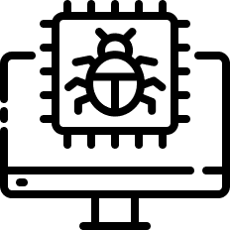
Cyber Kill Chain
Stage 4: Exploitation
Exploitation
In this stage, the exploit will be triggered once the target interacts (eg, clicks)
Use vulnerabilities to execute the code

Slide 8

Cyber Kill Chain
Stage 5: Installation
Installation
Involves attempting to install malware and other ransomware variants
The attacker will take control of the system
Try to install other cyberweapons, Trojan horses, backdoors, and command-line interfaces.

Slide 9

Cyber Kill Chain
Stage 6: Command and Control (C2)
C2
In the C2 phase, attackers will try to communicate with the malware installed
Carrying out specific tasks remotely is done here
Attackers will try to overload websites with traffic or instruct C2 servers to carry out their misssion

Slide 10
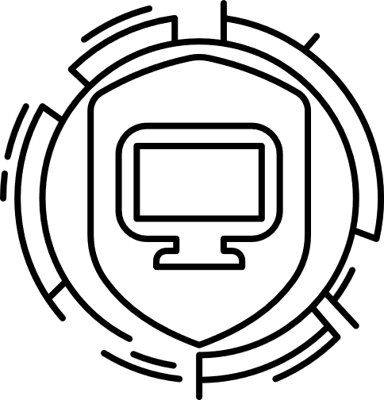
Cyber Kill Chain
Stage 7: Actions on Goals
Actions on Goals
Mitigation & Defense
This is the final stage, where attackers will try to carry out their objectives
The result depends upon the attacker’s goal
Some attackers interrupt services, to take them down or make them completely online
Some prefer stealing sensitive data, while others use denial of service, or ransomware attack.
Regular updates and strong security policies like changing passwords routinely, and never responding to suspicious emails
Use Intrusion Detection System / Intrusion Prevention System, email filters, EDR, and user training
Stop attacks early (ideally at Recon or Delivery
References - https://www.lockheedmartin.com/content/dam/lockheed-martin/rms/photo/cyber/THE-CYBER-KILL-CHAIN-body.png.pc-adaptive.full.medium.png
Thank You
Stay Safe, Stay Smart

